Slide 1
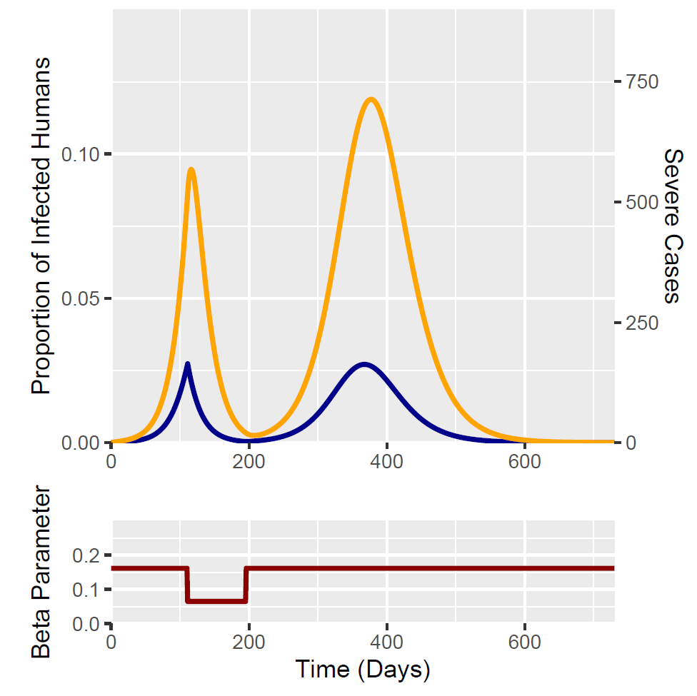
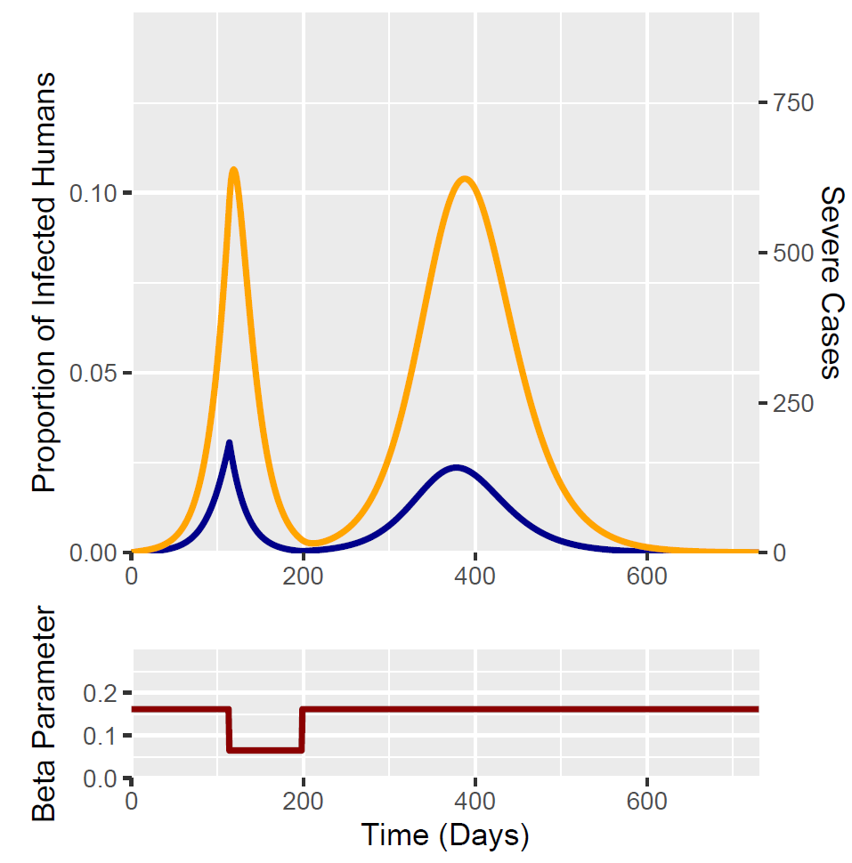
Optimised Peak I
Optimised Peak C
Orange = Severe
Blue = Normal Inf
 | Optimised Peak I | Optimised Peak C
Trigger point | 111 | 114
Peak I | 0.0273 | 0.0306
Day of peak I | 111 | 114
Peak C | 0.000142683 | 0.0001277437
Peak C (at N = 5 million.) | 713.4155 | 638.719
Day of Peak C | 377 | 119
Total R | 0.5053 | 0.4948

